Slide 1
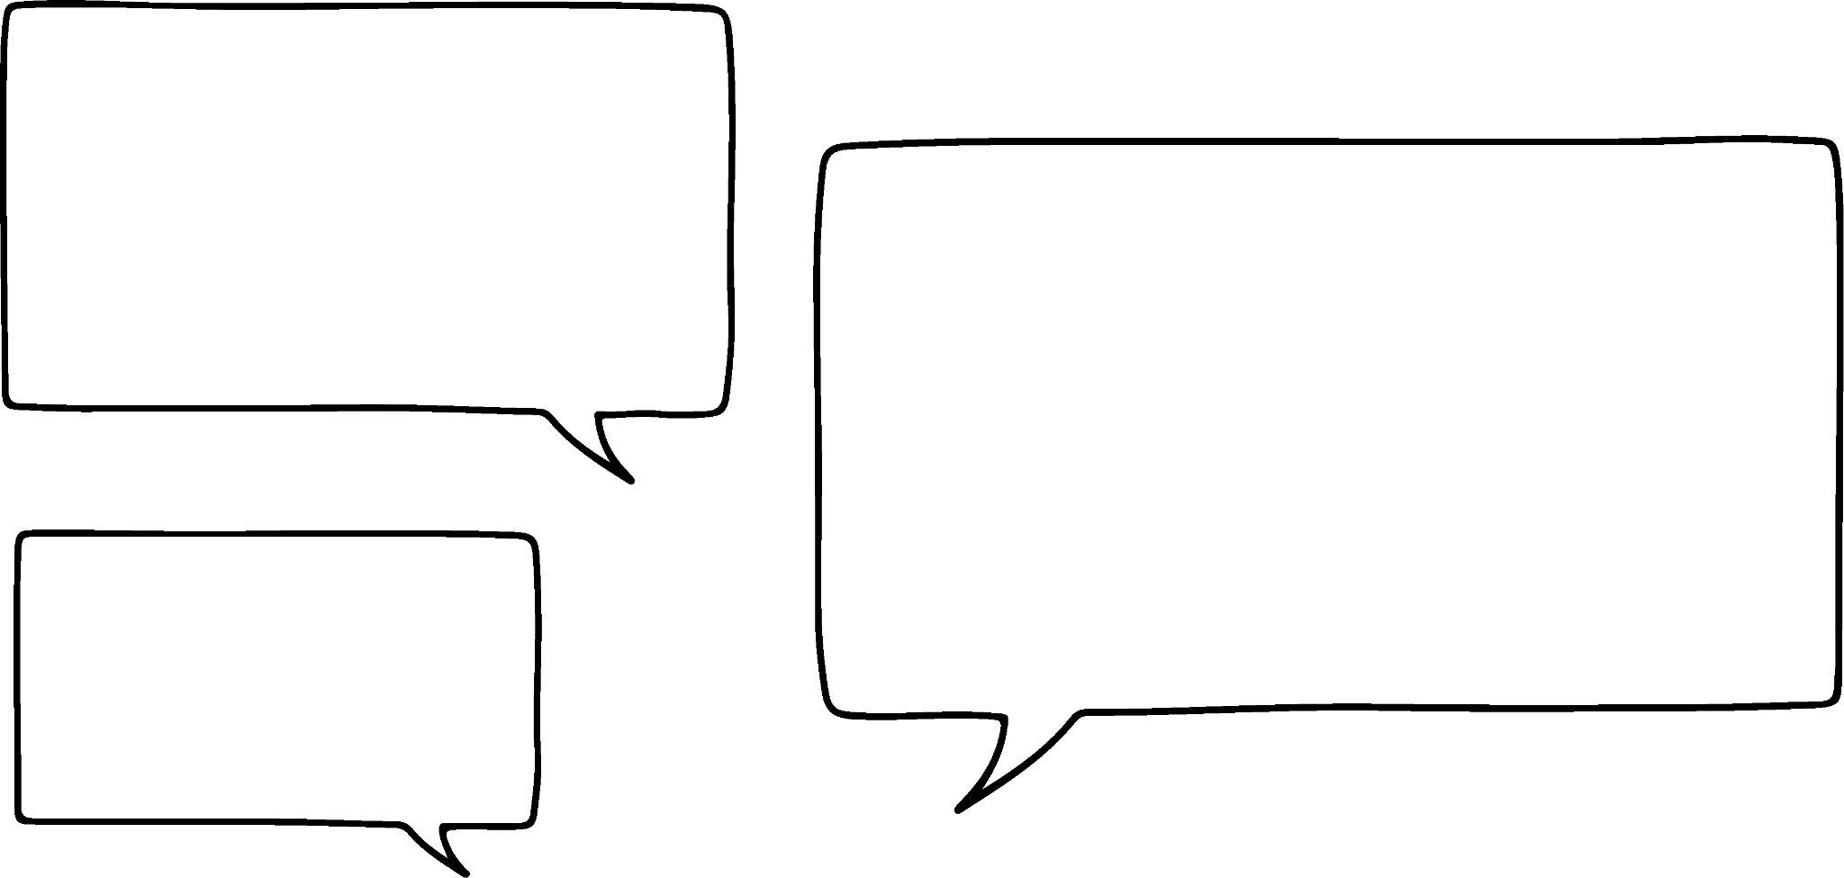
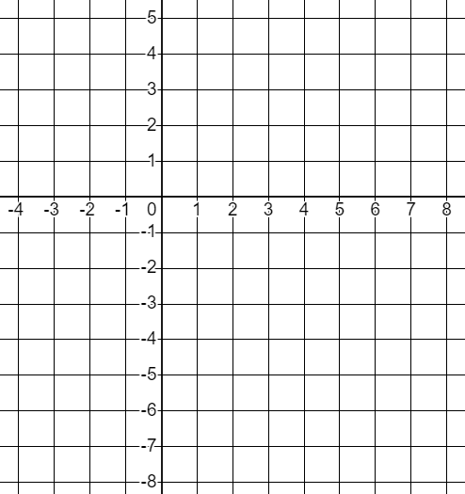


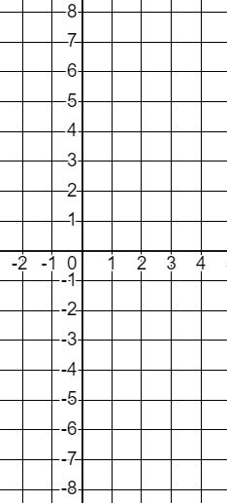
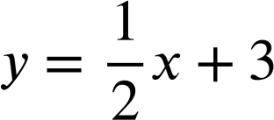
Checking and securing plotting a relationship
Task A: Checking understanding of plotting a coordinate
1) Laura says...
Laura’s number
Whatever number Andeep chooses I’m going to subtract 4 from it.
Andeep’s number
Plot some points to graphically represent this relationship.
2) Complete the tables of values and plot these relationships.
a)
x | −2 | −1 | 0 | 1 | 2 | 3 | 4
y
y = 2x − 3
b)
x | −2 | −1 | 0 | 1 | 2 | 3 | 4
y
x + y = 4
c)
x | −2 | −1 | 0 | 1 | 2 | 3 | 4
y
d)
x | −2 | −1 | 0 | 1 | 2 | 3 | 4
y
y = 4 − 2x

Slide 2

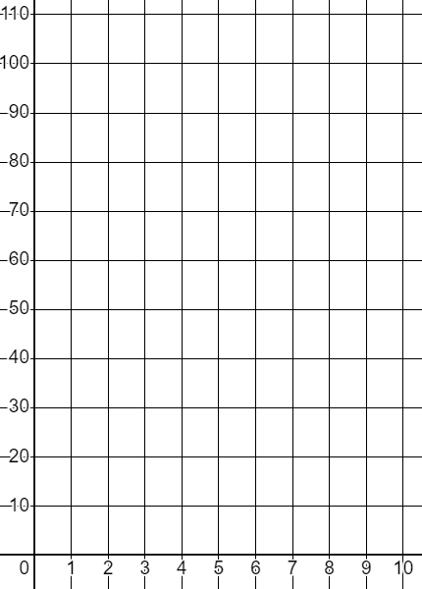
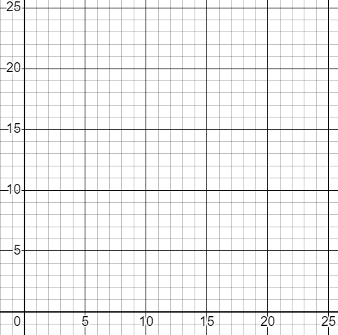
Checking and securing plotting a relationship
3) Complete the tables of values for this relationship.
y = 1.5x − 0.8
x | 0 | 0.2 | 0.4 | 0.6 | 0.8 | 1
y
Draw suitable axes to graphically represent the coordinates.
Task B: Securing understanding of plotting a relationship
1) This time Andeep is squaring Laura’s number and adding 10.
Laura (L) | 1 | 2 | 3 | 4 | 5 | 6 | 7 | 8 | 9 | 10
Andeep (A) | 11 |  |  |  | 35
1
11
5
35
a) Complete the table of values and plot the relationship.
Andeep’s number
b) Explain why (5,25) is not on this curve.
Laura’s number
c) Write this relationship algebraically.
2) This time our Oak children are sharing 24 apples.
a) Complete the table of values and plot the relationship.
People (p) | 1 | 2 | 3 | 4 | 6 | 8 | 12 | 24
Apples (a)
b) Write this relationship algebraically.
Apples (a)
People (p)
Mathematics in Education and Industry
v2.2

